Slide 1
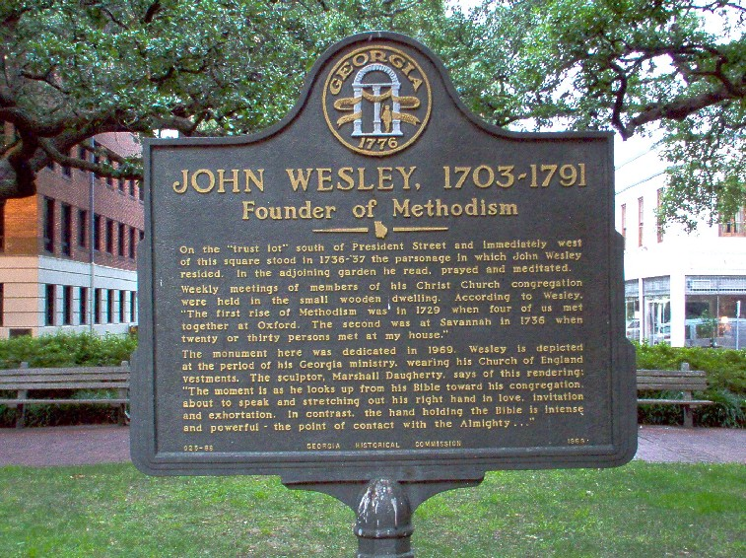
Notes:
While the 16th century saw the rise of Protestantism led by men such as Luther and Calvin, the 17th century saw Protestantism develop into a system of orthodox dogma that became intellectually driven. This was in large part a result of the Renaissance, a rebirth of intellectualism and scholarship. This system of scholasticism caused many to become more interested in dogma than in expressing Christianity in practical life. A coldness and formalism developed in the Church of England that led some into a revival of sorts, where more emphasis began to be placed on the bible and personal piety. While the Puritans were the first to protest the Catholic elements within the Church of England, others that came later began protesting against its coldness and rigidity. From this revivalism came the Methodists.

Slide 2
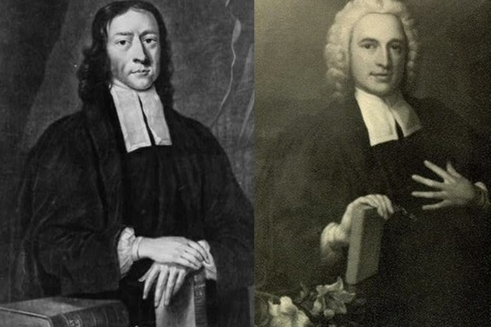
Origin
John and Charles Wesley
Studied at Oxford University
Sons of a Church of England clergyman
John ordained a Church of England priest
Along with George Whitefield, they formed a religious club
Protesting the formality, coldness, indifference, and ungodliness in the Church of England
Members adopted strict methods of study, diet, exercise, etc.
No intention of starting a denomination
Nicknames
“Bible Moths”, “Bible Bigots”, “Holy Club”
Dubbed “Methodists”
Name eventually chosen as official name
Notes:
John Wesley was the 15th of 19 children. He entered Oxford in 1720 on scholarship and was ordained a priest in the Church of England in 1728. Eventually Charles, his older brother John, and George Whitfield formed a religious club. In this club, they devoted themselves to bible study, prayer, strict diet and exercise, and attempts at social services in jails and homes of the poor. Because of their methodical approach to religion, others in the college made fun of them, nicknaming them the “Holy Club”, “Bible Moths”, “Bible Bigots”, “Sacramentarians”, etc. Eventually the term “Methodists” was used and later adopted as the denominational designation that sprang from this group.
Their intention was not to start a new denomination. In fact, when it was first suggested by Charles that they do so, John disagreed with him and it caused a sharp divide between the brothers for a time. But much like the Catholic church, the Church of England was too immersed in its falsities to ever change. It was inevitable that the Methodists would branch out on their own.

Slide 3
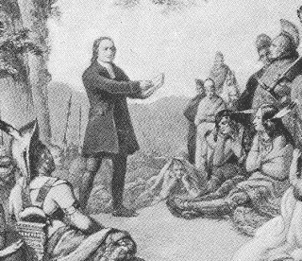
Methodism In America
In 1736, the Wesley's came to Georgia
Charles was secretary to Gen. Oglethorpe and John was a missionary to the Indians
Mission largely unsuccessful, but on the ship John met a group of Moravians who inspired him by their piety
Returning to London 2 years later, John attended a Moravian service in Aldersgate St., London and heard Luther’s preface to the book of Romans read.
“I felt my heart strangely warmed; I felt that I did trust in Christ, in Christ alone for salvation; and an assurance was given me that He had taken away my sins, even mine and saved me from the law of sin and death.”
After this, Wesley began propagating the doctrine of “faith only.”
Notes:
In 1736, both Wesley boys came to Georgia, Charles as a secretary to General Oglethorpe and John as a missionary to the Indians. Charles brought his religious mentality with him – that of ritualism, strict churchmanship, and simplicity which caused difficulties with other parishioners. He was also not received well by the settlers and was eventually forced to go home in 1737.
John, however, was inspired by the courage of the Moravians on the ship to Georgia and it had a profound influence on him such that he paid more attention to the Moravian church and allowed the thinking to permeate into Methodist doctrine. Too, John listened to a reading of Martin Luther’s preface to his “Commentary on Romans” and claims his heart was “strangely warmed” and he decided to trust in Christ alone for his salvation and to propagate this doctrine to his new group of Methodists.

Slide 4
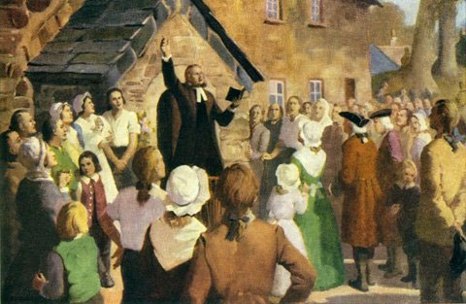
Methodism In America
As these men went out to preach, they found the pulpits of the Church of England closed to them
They preached on the streets, homes, barns, mining pits
Converts to their doctrine came thick and fast
In 1740, an old abandoned government building known as “the foundry” became the headquarters for the movement
Notes:
On his return to Europe, Wesley wanted to preach but the Church of England closed its pulpits to him. He therefore began engaging in field preaching in which he is said to have traveled more than 200,000 miles on horseback in England, Scotland, and Ireland and to have preached about 42,000 sermons, wrote 200 books, wrote 700 hymns (“And Can It Be”, “Christ The Lord Is Risen Today”, “Hark! The Herald Angels Sing”, “Love Divine”), and organized his followers to Methodism. In 1740, he bought an old abandoned government building called the “Foundry” and used it as his headquarters.
Though Wesley didn’t want to separate from the Church of England and even organized his converts into societies similar to that of the Church of England, upon his death in 1791, the Methodist church permanently split from the Church of England in 1795.

Slide 5
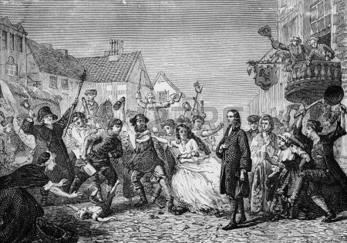
Methodism In America
Prior to the Revolutionary War, the Organization invaded the colonies
Methodism “Americanized” quickly and grew during the war
Today the Methodist Church is divided into perhaps 15 to 20 groups, with a total membership exceeding 11,000,000 in the U.S.
Notes:
Methodism was planted in America before the Revolutionary War, even though its success was scarce. But really took off during the war when sentiment towards England was at an all time low. A minister by the name of Thomas Coke was set apart by Wesley to be “superintendent” over the Methodist Church in America and it later set up its own national organization.
Now 250 years later, the Methodist Church is divided up into 15 to 20 different denominations with a membership exceeding 11,000,000 people.

Slide 6
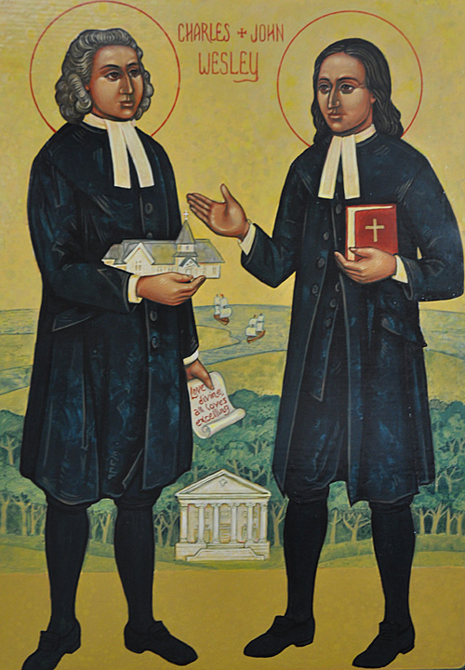
Motive
Motive as stated by Methodist Creed
Methodist Discipline (1908, p. 15): “In 1729, two young men in England, reading the Bible saw they could not be saved without holiness, followed after it, and incited others so to do. In 1737, they saw, likewise, that men are justified before they are sanctified; but still holiness was their object. God then thrust them out to raise a holy people. This was the rise of Methodism, as given in the words of its founders, John and Charles Wesley, of Oxford University, and Presbyters of the Church of England.”
Notes:
The motive for these men beginning this group is stated in its own Methodist disciple as being a desire for holiness. They also saw from the bible the need to be justified before being sanctified. However, it is interesting that the Methodist creed then states this beginning was the will of God. The problem with this statement, though, is that so many of the doctrines of the Methodist Church are foreign and contradictory to scripture, including the name they chose to identify their followers. It begs the question that if God truly thrust them out, why they were not content to let His word define their group.

Slide 7
Methodist Doctrine
In 1784, Methodist Church adopted its discipline (abridgement to Episcopalian Prayer Book)
In the 1908 edition (p. 3), this statement is made: “Dearly beloved brethren: it is our privilege and duty to recommend most earnestly this volume to you, which contains the Doctrines and Disciplines of our Church, which we believe are agreeable to the Word of God, which is the only and the sufficient rule of faith and practice. Yet the Church, in the liberty given to it by the Lord, and taught by the experience of many years, and by the study of ancient and modern Churches, has from time to time modified its Discipline in order to secure the end for which it was founded.”
Then on page 4: “During the period in which this work has been extending, the Church has revised and enlarged its legislation to meet the demands created by its own success
Point: If the discipline and the NT taught the same, the discipline could not be modified (Deut 4:2; Rev 22:18-19; Gal 1:8-9)

Slide 8
Methodist Doctrine
In 1784, Methodist Church adopted its discipline (abridgement to Episcopalian Prayer Book)
Illustration of the changes in the Methodist Discipline:
“Dearly beloved, forasmuch as all men are conceived and born in sin… (M.D., 1908, p. 349)
“Dearly beloved, forasmuch as all men are heirs of eternal life eternal…” (M.D., 1948, p. 470)
Note: Up until 1910, babies were born in sin and would go to hell if they died that way. Since 1910, they are born in Christ and will go to heaven. Babies began to be born differently in 1910, according to the Methodists.

Slide 9
Methodist Doctrine
Baptism
Three “modes”. “Let every adult person, and the parents of every child to be baptized, have the choice of either sprinkling, pouring, or immersion” (M.D., 1908, p. 349)
Infant Baptism: “It (the Methodist Church) baptizes them (babies) in anticipation of their joining the church” (From The Beliefs of a Methodist Christian, by Clinton M. Cherry, p. 67).
Actually, Methodists don’t know why they baptize babies since they discarded Calvin’s doctrine of total hereditary depravity
Baptism is non-essential in Methodist doctrine. “No baptism is valid, regardless of its mode or the ritualistic words used, unless there is repentance, forgiveness, and a new life in God for the believer” (Ibid., p. 68)

Slide 10
Methodist Doctrine
Salvation by faith only
“Wherefore that we are justified by faith only is a most wholesome doctrine, and very full of comfort” (M.D., 1908, Art. IX)
Jas 2:24 – “You see that a man is justified by works and not by faith alone.”
Second work of grace
Wesley taught justification by faith was followed by either an instantaneous or gradual experience of regeneration (holiness)
Wesley’s belief in a “second work of grace” was interpreted by some as being instantaneous (baptism of the Holy Spirit)
This led to the Holiness Movement from which Pentecostalism sprung

Slide 11
Methodist Doctrine
Instrumental Music
“I have no objection to instruments of music in our chapels provided they are neither heard nor seen.” – John Wesley
At the dedication of an organ in worship, the minister is to say, “In the name of the Father, and of the Son, and of the Holy Spirit, we dedicate this organ to the praise of the Almighty God” (M.D., 1948, P. 550)
“In the name of” means “by the authority of.” Where is the authority for an organ or any instrument of music in the worship of the NT church?

Slide 12
Methodist Doctrine
Marriage, Divorce, & Remarriage
Matt 19:9 – “And I say unto you, Whosoever shall put away his wife, except for fornication, and shall marry another, committeth adultery: and he that marrieth her when she is put away committeth adultery.”
Methodist Creed Book, 1896: No divorce, except for adultery, shall be regarded by the Church as lawful; and no Minister shall solemnize marriage in any case where there is a divorced wife or husband living; but this rule shall not be applied to the innocent party to a divorce for the cause of adultery, nor to divorced parties seeking to be reunited in marriage.
Methodist Creed Book, 1914: The Ministers of our Church shall be prohibited from solemnizing the rites of matrimony between divorced persons, except in the case of innocent parties who have been divorced for the one scriptural cause.
Methodist Creed Book, 1940: No Minister shall solemnize the marriage of a divorced person whose wife or husband is living and unmarried; but this rule shall not apply (1) to the innocent person when it is clearly established by competent testimony that the true cause for divorce was adultery or other vicious conditions which through mental or physical cruelty or physical peril invalidated the marriage vow, nor (2) to the divorced persons seeking to be reunited in marriage.

Slide 13
Methodist Doctrine
Marriage, Divorce, & Remarriage
Matt 19:9 – “And I say unto you, Whosoever shall put away his wife, except for fornication, and shall marry another, committeth adultery: and he that marrieth her when she is put away committeth adultery.”
Methodist Creed Book, 1960: In view of the seriousness with which the Scriptures and the Church regard divorce, a minister may solemnize the marriage of a divorced person only when he has satisfied himself by careful counseling that (a) the divorced person is sufficiently aware of the factors leading to the failure of the previous marriage, (b) the divorced person is sincerely preparing to make the proposed marriage truly Christian, and (c) sufficient time has elapsed for adequate preparation and counseling.
Methodist Creed Book, 1984: Where marriage partners, even after thoughtful consideration and counsel, are estranged beyond reconciliation, we recognize divorce as regrettable but recognize the right of divorced persons to remarry. We express our deep concern for the care and nurture of the children of divorced and/or remarried persons. We encourage that either or both of the divorced parents be considered for custody of the minor children of the marriage. We encourage an active, accepting, and enabling commitment of the church and our society to minister to the members of divorced families.

